Slide 1
K-Nearest Neighbour
(K-NN) Classifier
Sourav Karmakar
souravkarmakar29@gmail.com

Slide 2
OUTLINE
Euclidean Distance
Other Distance Metrics
K-NN Classifier
Decision Boundary of K-NN Classifier
Choosing the value of K
Merits and Demerits of K-NN classifier

Slide 3








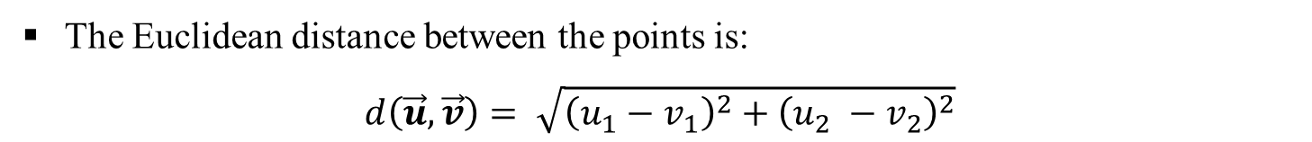



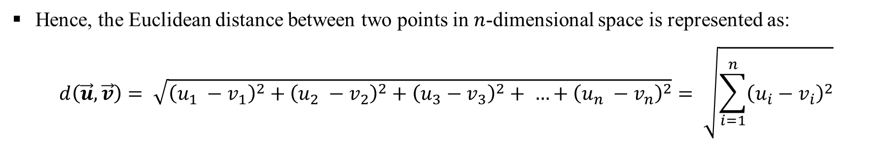
EUCLIDEAN DISTANCE
Consider the points in two-dimension. Each point in two-dimension can be represented by a vector of dimension two.

Slide 4
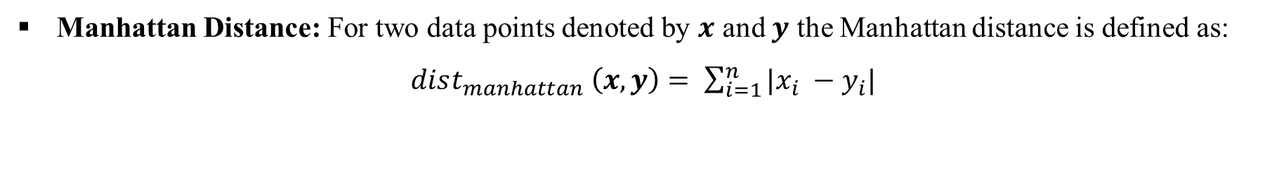
OTHER DISTANCE METRICS
There are other distance metric like: Mahalanobis Distance, Bhattacharya Distance etc. which are used for advanced statistical pattern recognition tasks.

Slide 5

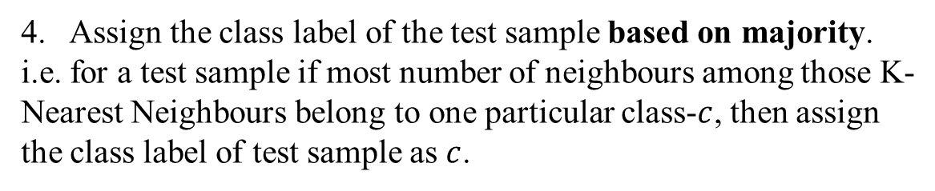

K-NN CLASSIFIER
Intuition: One is known by the company one keeps.
K-NN Algorithm:
All the training samples/ points are available beforehand.
Class-1
Class-2
2. When a new test sample arrives calculate its distance from all training points.
3. Choose K-nearest neighbours based on the distance calculated. Usually the K is a positive odd integer and supplied by user.
K = 3
Characteristics of K-NN Classifier:
It doesn’t create model based on the training patterns in advance. Rather, when a test instance comes for testing, runs the algorithm to get the class prediction of that particular testing instance. Hence, there is no learning in advance.
Hence, k-NN classifier is also known as Lazy Learner.

Slide 6


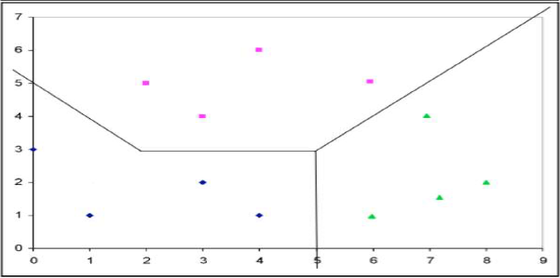
K-NN CLASSIFIER: DECISION BOUNDARY
Boundary are the points those are equidistant between the points of Class-1 and Class-2
Decision Region for Class-2
Construct lines between closest pairs of points in different classes.
Decision Region for Class-1
Draw perpendicular bisectors. End bisectors at intersections.
Class-1
Note that locally the boundary is linear.
Class-2
Hence the decision boundary is piecewise linear curve.
For multiclass classification also the same thing
is done to find the decision boundary.

Slide 7
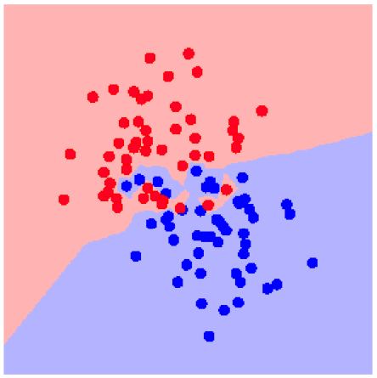
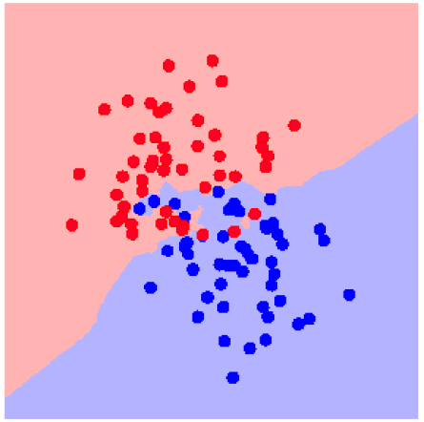
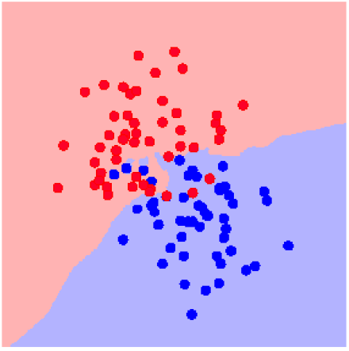
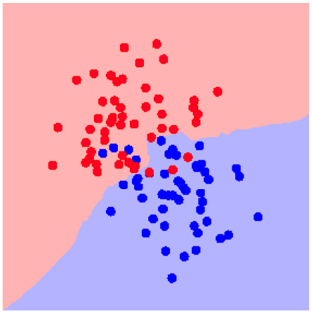
K-NN: CHOOSING THE VALUE OF K
Increasing the ‘K’ simplifies the decision boundary. Because majority voting implies less emphasis on individual points
K = 1
K = 3
K = 5
K = 7
However increasing the K also increases computational cost.
Hence, choosing K is an optimization between how much simplified decision boundary we want vs. how much computational cost we can afford.
Usually K = 5, 7, 9, 11 works fine for most practical problems.

Slide 8
K-NN CLASSIFIER: MERITS AND DEMERITS
Merits:
K-NN Classifier often works very well for practical problems.
It is very easy to implement, as there is no complex learning algorithm involved.
Robust to Noisy Data.
Demerits:
Choosing the value of K may not be straightforward. Often the same training samples are used for different values of K, and we choose the most suitable value of K based on minimum misclassification errors on test samples.
Doesn’t work well for categorical attributes.
Can encounter problem with sparse training data. (i.e. data points are located far away from each other)
Can encounter problems in very high-dimensional spaces.
Most points are at corners.
Most points are at the edge of the space.
This problem is known as Curse of Dimensionality and affect many other Machine Learning algorithms.

Slide 9



Slide 10























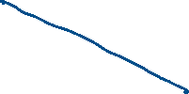


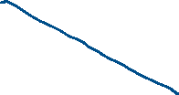

Slide 11
Thank You

